Slide 1
England in 1060
Should William of Normandy attack?

Slide 2
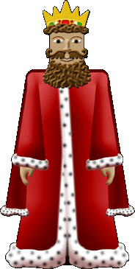
HELP! Nobody will do as I say!
Edward the Confessor was King
He had trouble keeping control of the country.

Slide 3
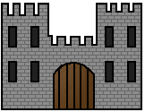
Most of England was poorly defended.
There were very few castles.

Slide 4
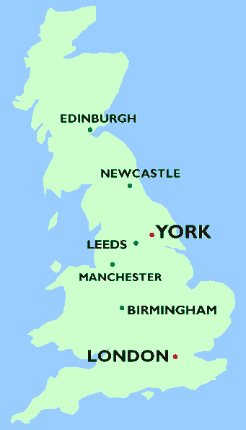
Very few people lived in the north and west of England.
Everybody lived in the south.
Most of the South of England was covered in forest and people lived in villages.

Slide 5
England’s army is strong.
England’s army is scattered.

Slide 6
William’s army was strong.
William’s army lived and trained together.

Slide 7
This powerpoint was kindly donated to www.worldofteaching.com
http://www.worldofteaching.com is home to over a thousand powerpoints submitted by teachers. This is a completely free site and requires no registration. Please visit and I hope it will help in your teaching.

